Slide 1
Data Science - Capstone Project
By - Anthony valantra
Mentor - Mike Badescu

Slide 2
Who is the client
The client is the HR department for company ABC.
Problem Statement
Why are best and most experienced employees of ABC leaving prematurely.
Explore the factors that are important to the employees.
Provide recommendation to HR department to lower attrition rate and save on hiring costs.
Build a predictive model to determine their probability in leaving.

Slide 3
Dataset
Source - https://www.kaggle.com/ludobenistant/hr-analytics
About data
14,999 Observations
Observations are described by 10 attributes

Slide 4
Data Exploration
We start by looking at correlation of satisfaction level of employee and whether they have left or not with below attributes:
number of project,
average monthly hours,
time spend with the company,
promotion(in last 5 years),
Work accident,
salary level &
department.

Slide 5
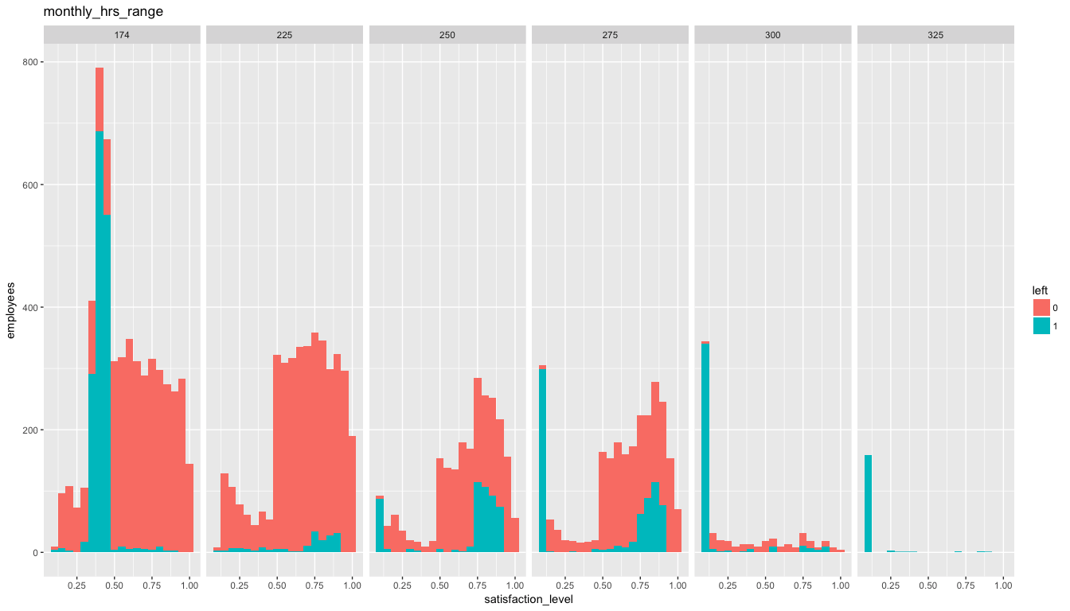
Data Exploration
Overall we see employees involved in 3-5 projects and spend 174 – 225 average monthly hours ( 8 – 10 hours a day), have high satisfaction level and low attrition rate
Notes:
Number projects
- Most of employees having 2 projects are showing a high rate of leaving most of them seem to be mid level satisfaction level.
- Most of the employees having 3 - 5 projects are having high satisfaction level. We can also see employees leaving creeping between 3 - 5 projects and most of employees leaving are having high satisfaction level too.
- 6 - 7 projects however we see satisfaction level being very low and a very high rate employees leaving.
Average_monthly_hours
- Since average_montly_hours is continuous data, in order for being able to use as a facet lets make it a discrete by creating ranges / monthly_hrs_range. Starting at 174 hours as that is normal average monthly hours.
- Employees putting in 174 and less average monthly hours show medium satisfaction and very high rate of leaving.
- Employees putting in 174 - 225 average monthly hours seems to have higher satisfaction level. Though we can see a small peak in employees leaving in this category. (8-10 hrs a day)
- Employees putting in 225 - 275 average monthly hours show mostly higher satisfaction level and we can see rate of leaving in high satisfaction level creeping. (10 - 13 hours a day)
- Employees putting in 275 hours and more average monthly hours are having a very low satisfaction level and are mostly leaving.

Slide 6
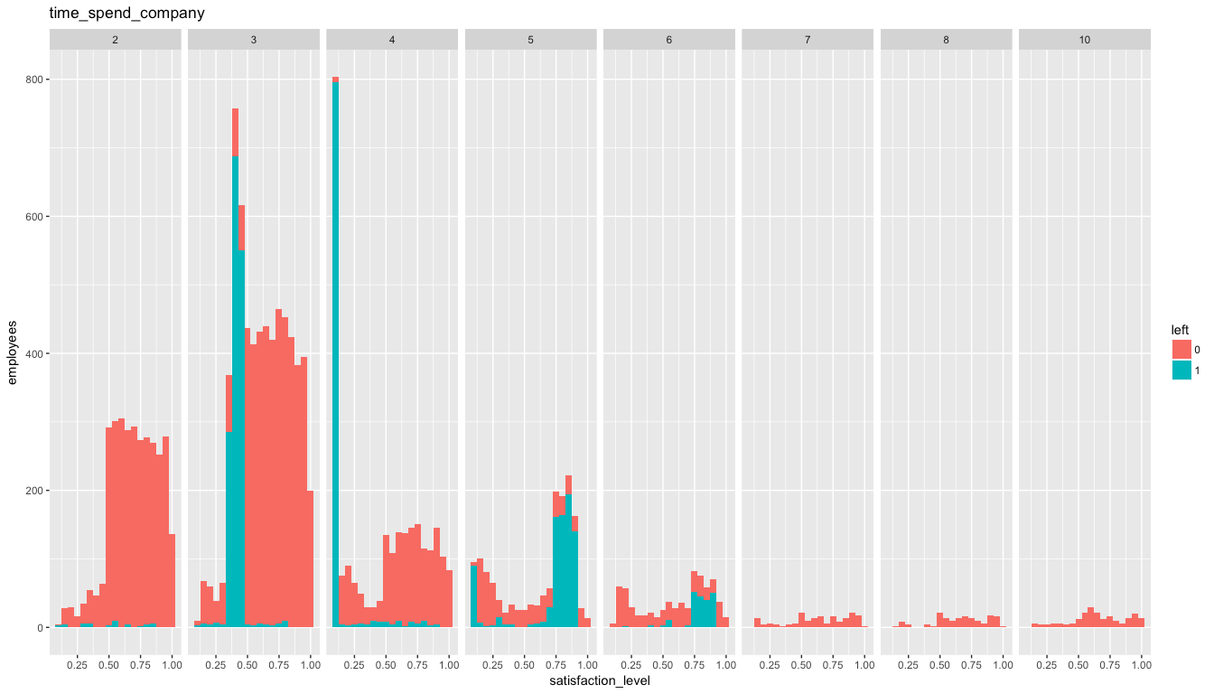
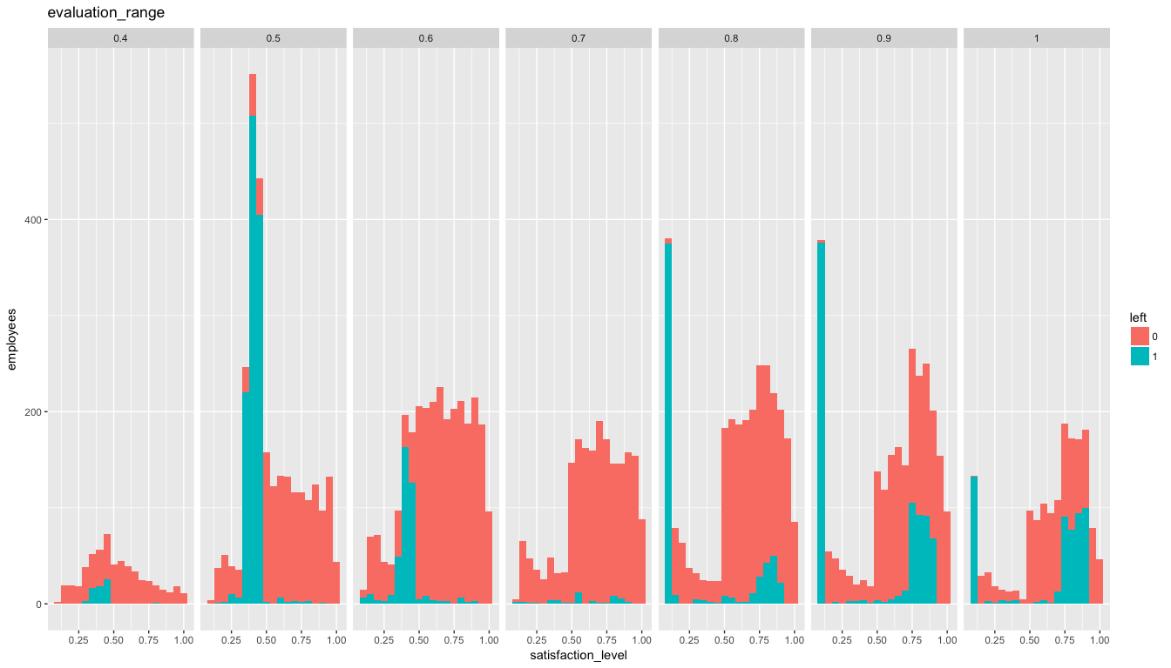
Data Exploration
High rating does not equate directly to level of satisfaction as shown by peaks in low satisfaction. Also both at high and low rating level we see folks quitting. So maybe improved rating is not resulting to some kind of bonus or the bonus is not enough?
Employees who have been 4 years tend to show low attrition but beyond that we see attrition increasing. Perhaps work has become less challenging
Notes:
Last evaluation
- Since last evaluation is continuous data, first lets round the last evaluation to 1 place and then make it into a factor
- Employees having evaluation rating 0.4 - 0.6, show satisfaction levels improving with rating and employees leaving have mostly medium satisfaction level.
Employees at 0.7 rating show higher satisfaction level and low rate of quitting.
Employees having higher rating of 0.8 – 1, with increasing rating we see folks leaving with low satisfaction level gradually reducing but then employees with high satisfaction and leaving is slowly creeping up.
Time_spend_company
- Employees who have spent 2 years show very low rate of leaving and seem to have high satisfaction
- Employees who have been with the company 3 years show high satisfaction level among folks who remain but mostly there is a segment with medium satisfaction who are leaving with high rate.
- Employees who have spent 4 years continue to have high satisfaction level among who remain, but has a segment which has low satisfaction level and are leaving at high rate.
- Employees who have been with company 5- 6 years however show a higher rate of leaving in higher satisfaction level.
- Employees who have been longer than 6 are very low and most of them stay.

Slide 7
Data Exploration - Observations
Number of project, average monthly hours, last evaluation are of significant interest for analyzing reasons for employees leaving.
It seems low satisfaction is driven by over work and medium satisfaction is due to less work (does less work means lower remuneration?).
Employees putting in 8-10 hours a day seems to be having higher satisfaction level and low rate of leaving.
Overall right sizing work across the workforce could improve overall satisfaction and company will be able to retain employees and improve overall employee utilization.
Employees who have spend beyond 4 years may be feeling work is not interesting any more or maybe feeling competitive enough to try opportunities. Maybe a combination of pay package and promotion to keep them interested.
Notes:
We can see 3 categories/patterns of employees who are leaving
high satisfaction level
Employees involved in 3 - 5 projects
Employees putting in 225 - 275 average monthly hours. (10 - 13 hrs)
Employees with a evaluation rating of 0.8 - 1.
Employees who have been with the company 5 - 6 years
medium satisfaction level
Employees involved in 2 projects
Employees putting in 174 and less average monthly hours. ( less than 8 hrs a day)
Employees having evaluation rating 0.4 - 0.6
Employees who have been with the company for around 3 years
low satisfaction level
Employees involved in 6 - 7 projects
Employees putting in 275 hours and more average monthly hours (More than 13 hrs a day)
Employees having evaluation rating 0.8 - 1 ( this group also has folks leaving at higher satisfaction level too)
Employees who have been with the company for around 4 years

Slide 8
Cluster Analysis
Used K-means clustering
Cluster analysis for data had 33.26% of point of variability and was not very conclusive.
On separating the data into set of employees who have left it improved to 51.25% of point variability
In the earlier exploratory analysis we were able to see different behavior at 3 satisfaction levels will use 3 clusters.

Slide 9
Cluster Analysis

Slide 10
Cluster Analysis - Observations
cluster 3 are employees that company need to find ways to retain. Based on earlier exploratory analysis we know keeping average monthly hours to 174 - 225 hrs or 8-10 hrs a day helps to maintain retention and employee satisfaction.
cluster 2 are over worked employees, company need to find ways to optimize work load and improve satisfaction level
cluster 1 are under under utilized employees and company need to find means to have them share the work load of cluster 2.
Overall right sizing work load and ensuring a 8 - 10 hours a day work load will go long way to have highly satisfied employee and low attrition rate.
Notes:
cluster 3
Employees having overall higher satisfaction level,
involved 3-5 projects,
spend 5 - 6 years.
higher evaluation rating (0.8 -1) and
average monthly hours of 225 - 275 hours. Assuming 22 working days a month, this translates to 10 - 13 hrs per day.
cluster 1
Employees having overall medium satisfaction level,
involved in less than 2 projects,
spend 3 - 4 years
low to medium evaluation rating (<0.6) and
low average monthly hours of less than 175 hours.
cluster 2
Employees having overall low satisfaction level,
involved in mainly 6 - 7 projects,
spend 4 -5 years
high evaluation rating (0.8-1) and
high average monthly hours of 225 - 350 hours. Assuming 22 working days a month, this translates to 10 - 16 hrs per day.

Slide 11
Model to predict Employees leaving
Attributes significant for the model to predict employees leaving:
Number of project,
time spend company,
Satisfaction level,
Work accident,
salary,
Last evaluation,
Average monthly hours,
Promotion(last 5 years),
department

Slide 12
Logistic Regression - Model
overall Accuracy of 0.89 against validation data as compared to 0.9 given by model data,
model is maintaining its accuracy levels and hence the model is repetitive and is representative of the problem.

Slide 13
Random Forest - Model
overall Accuracy of 0.99 against validation data as compared to 1.0 given by model data,
Though model is too perfect (accuracy of 1.0) it is maintaining its accuracy levels close enough with unseen data and hence the model is repetitive and is representative of the problem.

Slide 14
Recommendations
Random Forest Model is giving better prediction for employees leaving.
Overall right sizing work load and ensuring a 8 - 10 hours a day work load will go long way to have highly satisfied employee and low attrition rate.
High rating does not equate directly to level of satisfaction as shown by peaks in low satisfaction. Also both at high and low rating level we see folks quitting. So maybe improved rating is not resulting to some kind of bonus or the bonus is not enough?
Employees who have spend beyond 4 years may be work not exciting or competitive enough any more or maybe feeling competitive enough to try opportunities. Maybe a combination of pay package and promotion to keep them interested?

Slide 15
Dataset Dictionary
satisfaction_level - Employee Level of satisfaction. It ranges from 0 (low satisfaction) to 1 (high satisfaction)
last_evaluation - Latest performance evaluation rating of employee. It ranges from 0 (low rating) to 1 (high rating)
number_project - Number of projects completed while at work.
average_montly_hours - Average monthly work hours at workplace.
time_spend_company - Number of years spent in the company.
Work_accident - Whether the employee had a workplace accident. 1 indicates accident.
left - Whether the employee left the workplace or not. 1 means left .
promotion_last_5years - Whether the employee was promoted in the last five years. 1 means promoted and 0 means no promotion in last 5 years.
sales - Department in which they work for. Eg: accounting, hr, IT, management, marketing, etc.
salary - Salary as high, medium & low.

